Slide 1
Introducing Real-Time Integration Business Insight
Valencia, Oracle Fusion Middleware Partner Forum 2016
Lucas Jellema

Slide 2

Objectives
Learn what is going on inside the black box
In functional terms and from a business perspective
What happens, how often, when & what problems occur, where are bottlenecks
Monitor (live) & Report (later)
Drill down, inspect & analyze, operate
Decide in an iterative fashion what to watch
At runtime, no need for deployment cycles
Non invasive – no code changes required, no involvement of the development team
No potential to disrupt the execution of services and processes
Breaking the chain by observing it too closely
Low overhead
Service Bus
SOA Suite

Slide 3

Real-Time Integration Business Insight
Browser based tooling
Define a model of what to look out for
In business terms
Map the model to observables
In terms of Service Bus Services and SOA Composites
Go beyond composite sensors, pipeline alerts, BPEL sensors
Define at run time, non-invasive, iteratively
Even on third party components, deployed directly from SAR or JAR
Monitor end-to-end chains across ECID
Link message flows based on function identifier (aka correlation key)
Leverage BAM, link into OBI EE

Slide 4
Getting started at the business end
Actor: a business analyst or even a business owner
Define the Model
For a particular business process or end to end integration flow
Define Milestones – meaningful business states
One initial milestone, multiple terminal milestones, multiple error or error terminal milestones and multiple standard milestones
Define the logical identifier
The value that identifies instances of the process or flow
Define the business indicators
Dimensions: to classify and to aggregate by
Measures: to report and to aggregate

Slide 5


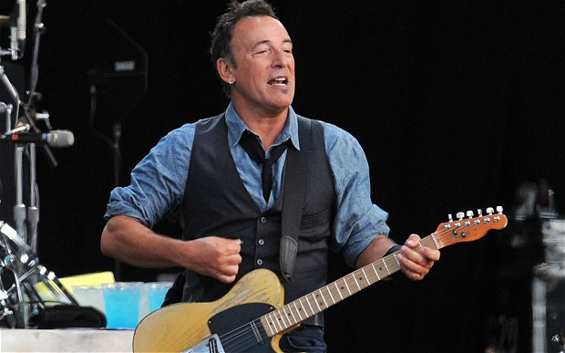
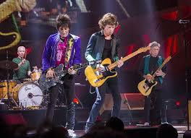
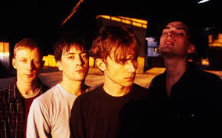
Example: Artist Proposal Management
Oracle OpenWorld 2016
AMIS Beyond the Horizon 2016
Oracle Fusion Middleware & PaaS Partner Community Forum 2017

Slide 6
High level process flow
Proposals are submitted by the community for an artist to perform at an event
Each proposal is checked for duplicates, then validated (against business rules)
Surviving proposals are submitted to a human actor for triage (approve/reject)
One or more approved proposals are selected to enter negotiotation phase with artist
When the negotation is successful, the proposal is converted to ‘engagement’; all other proposals are closed at that point
When the negotation is not successful, the proposal is converted to ‘not feasible’. Another one of the approved proposals can now be promoted

Slide 7
Milestones in the high level process flow
Initiated
In Process
Proposals are submitted by the community for an artist to perform at an event
Duplicate of approved
Each proposal is checked for duplicates, then validated (against business rules)
Duplicate of
in process
Invalid
Surviving proposals are submitted to a human actor for triage (approve/reject)
Under Consideration
Rejected
One or more approved proposals are selected to enter negotiotation phase with artist
Approved
Under negotiation
When the negotation is successful, the proposal is converted to ‘engagement’; all other proposals are closed at that point
When the negotation is not successful, the proposal is converted to ‘not feasible’. Another one of the approved proposals can now be promoted
Engagement
Closed
Not feasible

Slide 8
Business Indicators in Milestones in the high level process flow
Initiated
Proposal Identifier
In Process
Event
Artist
Number of Votes
Proposals are submitted by the community for an artist to perform at an event
Duplicate of approved
Each proposal is checked for duplicates, then validated (against business rules)
Duplicate of
in process
Invalid
Surviving proposals are submitted to a human actor for triage (approve/reject)
Under Consideration
Rejected
One or more approved proposals are selected to enter negotiotation phase with artist
Approved
Under negotiation
When the negotation is successful, the proposal is converted to ‘engagement’; all other proposals are closed at that point
When the negotation is not successful, the proposal is converted to ‘not feasible’. Another one of the approved proposals can now be promoted
Engagement
fee
Closed
Not feasible

Slide 9
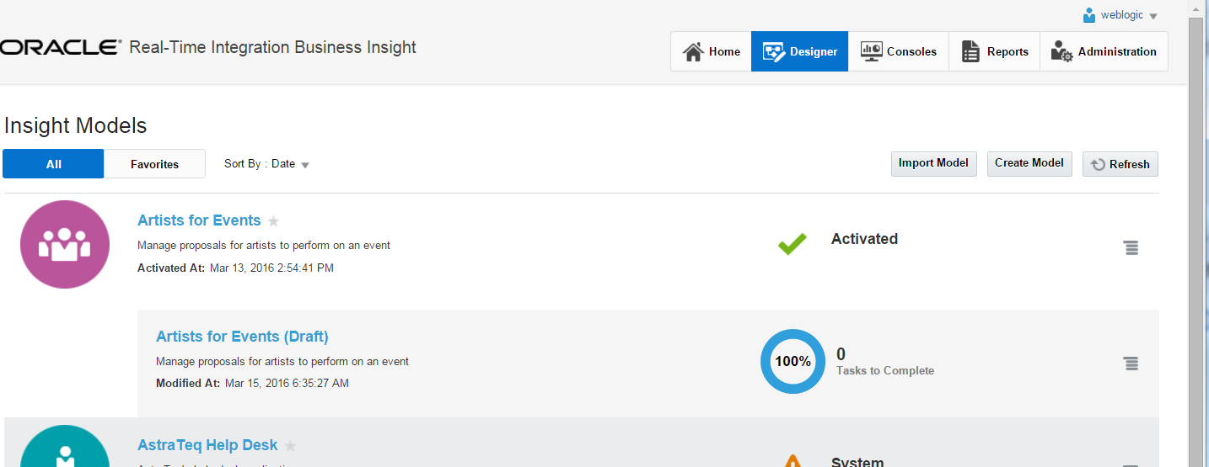
Live Model in Insight

Slide 10
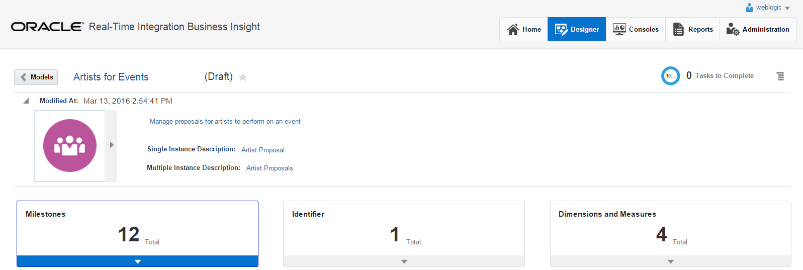
Live Model in Insight

Slide 11
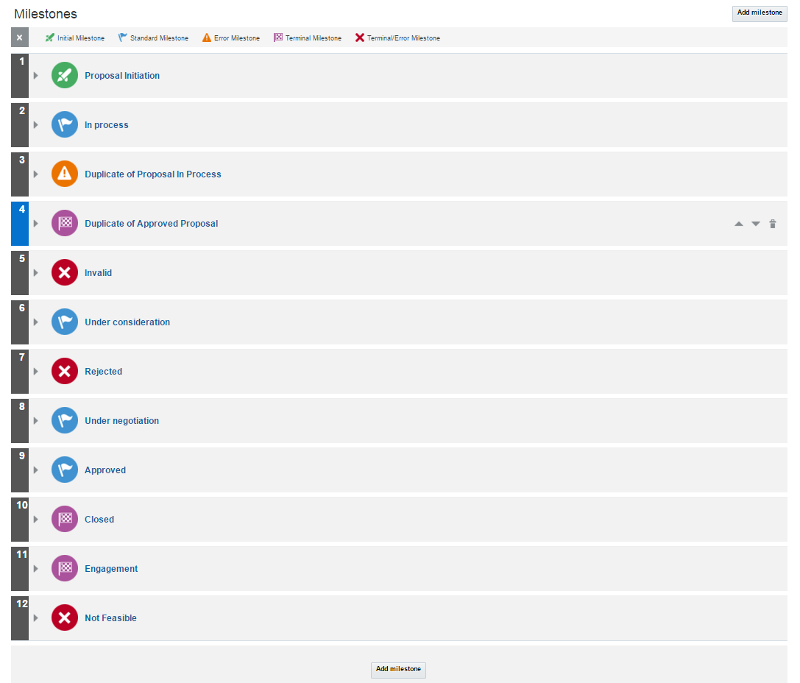
Live Model in Insight

Slide 12
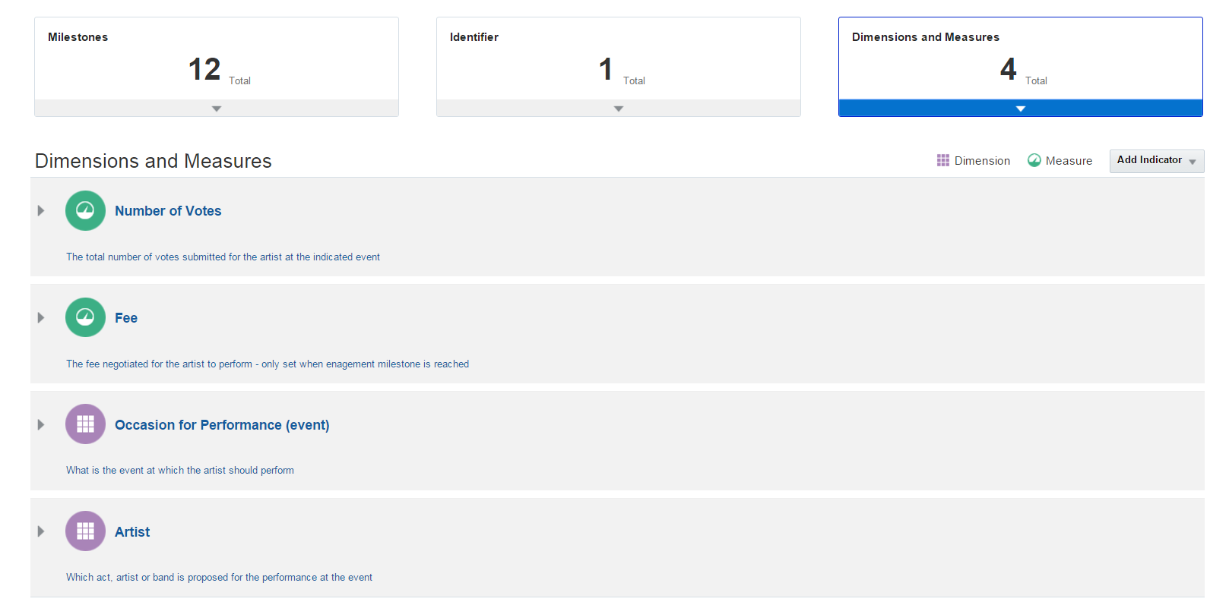
Live Model in Insight

Slide 13
Mapping the business view to the implementing components
Actor: Architect, Tech Savvy Analist, Developer or Tester
Map the Milestones (when does a flow reach a certain milestone)
Map to Service Bus Pipeline or Business Service
Map to SOA Service, Reference, Component (Mediator, Task, Business Rule) or BPEL activity
Note: Map to request or response (and for BPEL activity to: entry, exit or error)
Map the Identifier to a milestone
And define the XPath extraction criteria to determine the value of the identifier for a live instance
Note: the identifier is mapped once for every disconnected flow or: each ‘ECID’ needs its own identifier mapping
Map the (other) business indicators to milestones
And define the extraction formula to determine the value of the indicator at that milestone

Slide 14
Implementation of Artist Proposal Management flow
EvaluateArtistProposal
SOA Composite
SendInArtistProposal
REST
BR
B
Artist
Event
#votes
motivation
Service Bus
Pipe
line
SOA Composite
T
B
JudgeArtistProposal

Slide 15
Implementation of Artist Proposal Management flow
EvaluateArtistProposal
In Process
SOA Composite
Duplicate of approved
SendInArtistProposal
Duplicate of
in process
REST
BR
B
Invalid
Initiated
Artist
Event
#votes
motivation
Service Bus
Under Consideration
Pipe
line
SOA Composite
T
B
Rejected
JudgeArtistProposal
Approved

Slide 16
Implementation of Artist Proposal Management flow
EvaluateArtistProposal
In Process
SOA Composite
Duplicate of approved
Proposal Identifier
SendInArtistProposal
Duplicate of
in process
REST
BR
B
Invalid
Initiated
Artist
Event
#votes
motivation
Service Bus
Under Consideration
Pipe
line
Event
Artist
Number of Votes
Proposal Identifier
SOA Composite
Proposal Identifier
T
B
Rejected
JudgeArtistProposal
Approved

Slide 17
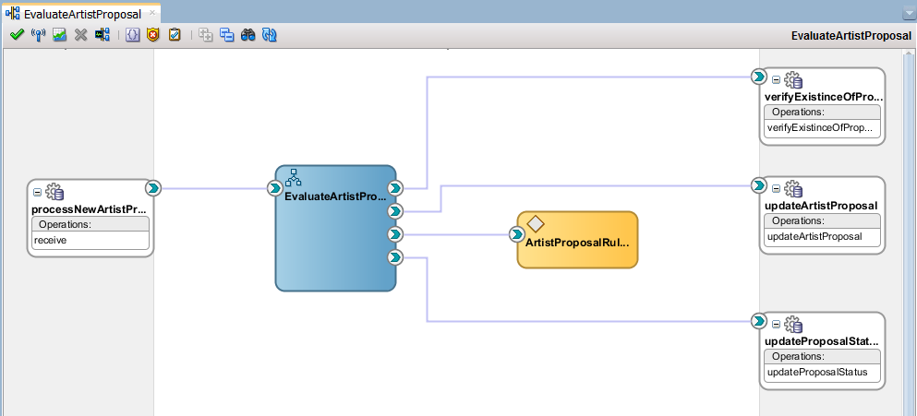
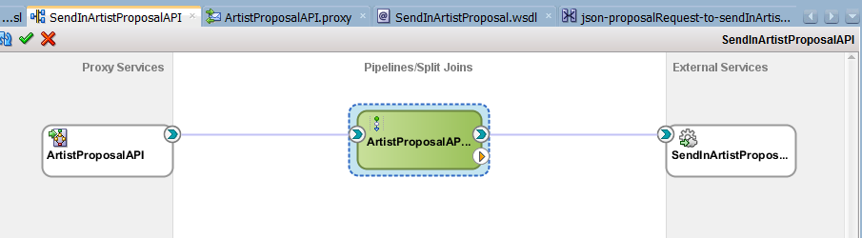
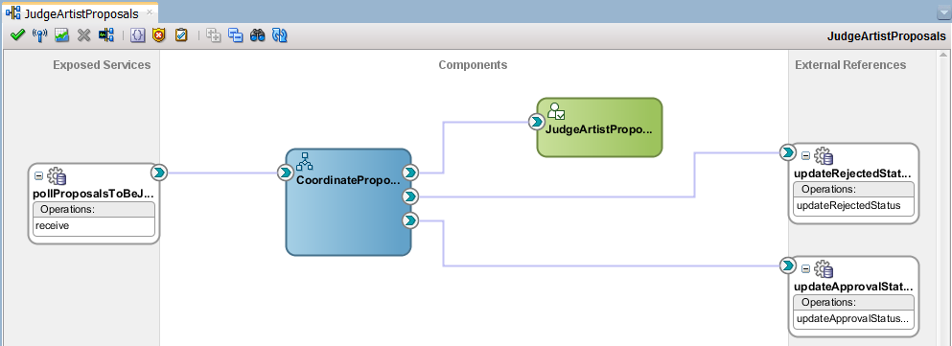
In Process
Proposal Identifier
Duplicate of approved
Artist
Event
#votes
motivation
Duplicate of
in process
Initiated
Invalid
Under Consideration
Proposal Identifier
Event
Artist
Number of Votes
Proposal Identifier
Rejected
Approved

Slide 18
Second part of flow
SOA Composite
BR
NegotiateAndEngage
B
SOAP
AgentNegotiator
Under Negotiation
ProposalIdentifier
MaximumFee
SOA Composite
BPEL
Under negotiation
SOA Composite
fee
B
Engagement
ProposalClosure
Closed
Not feasible

Slide 19
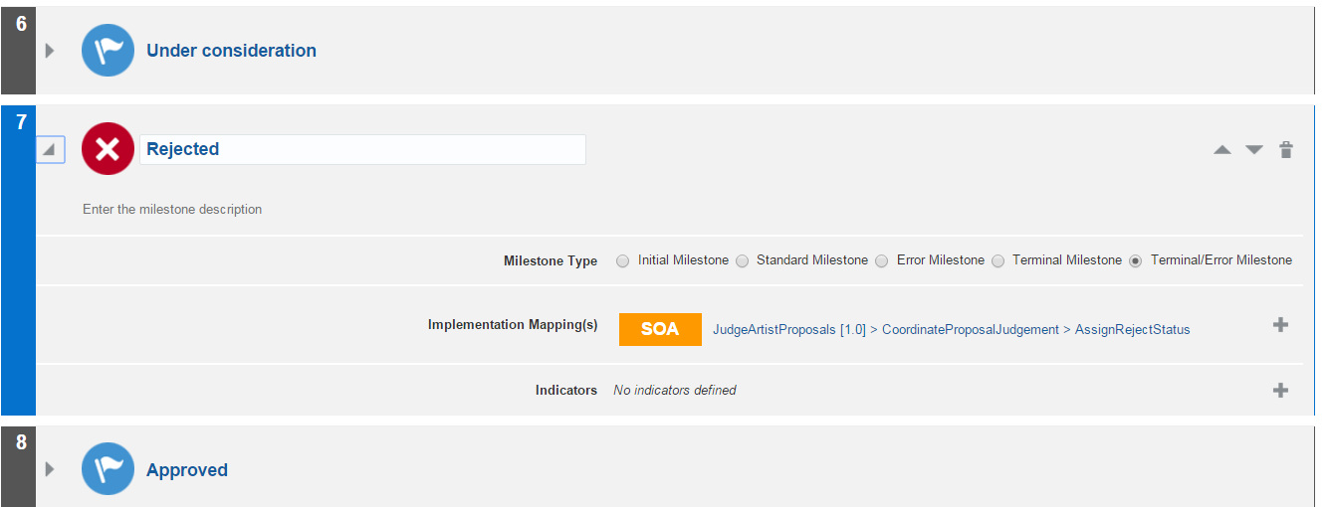
Mapping Milestone to Component

Slide 20
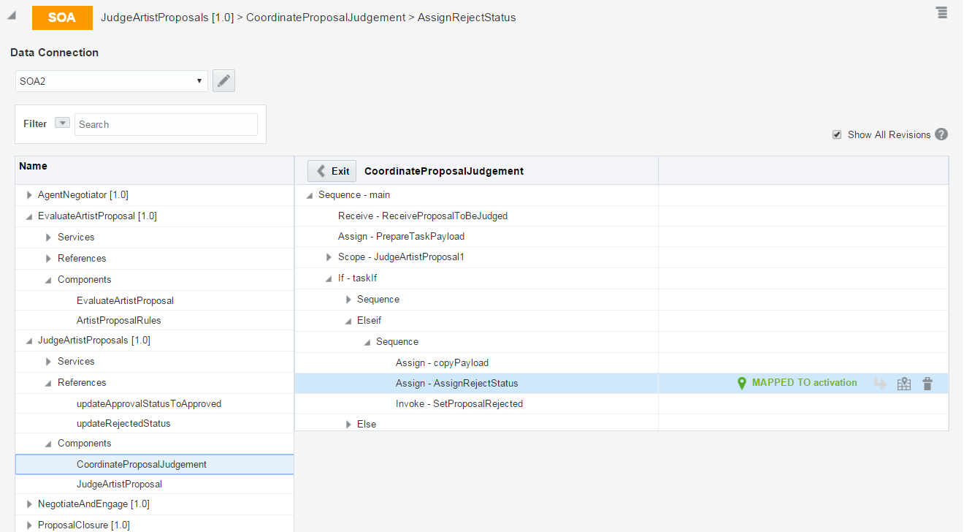
Mapping Milestone to Component

Slide 21
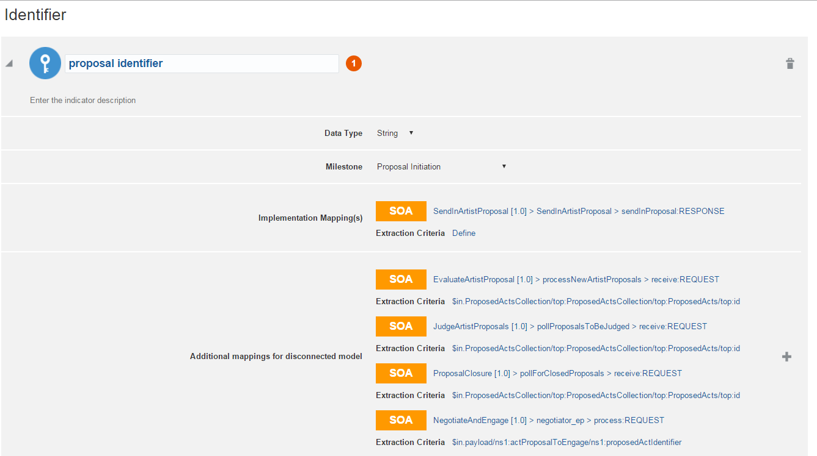
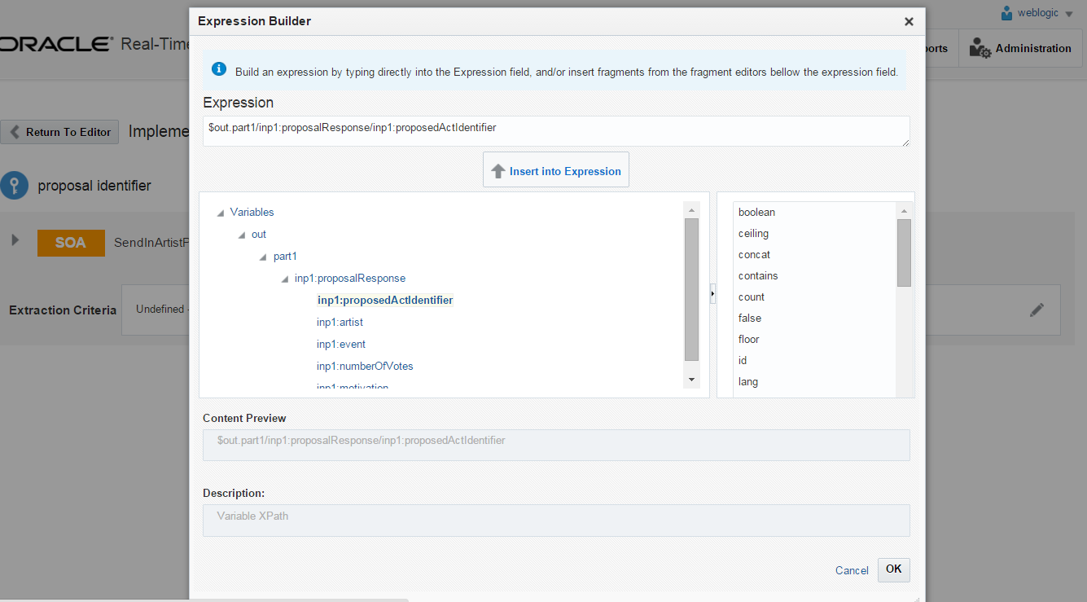
Mapping Identifier to Milestone and Extracting the value

Slide 22
Mapping Identifier to Milestone and Extracting the value

Slide 23
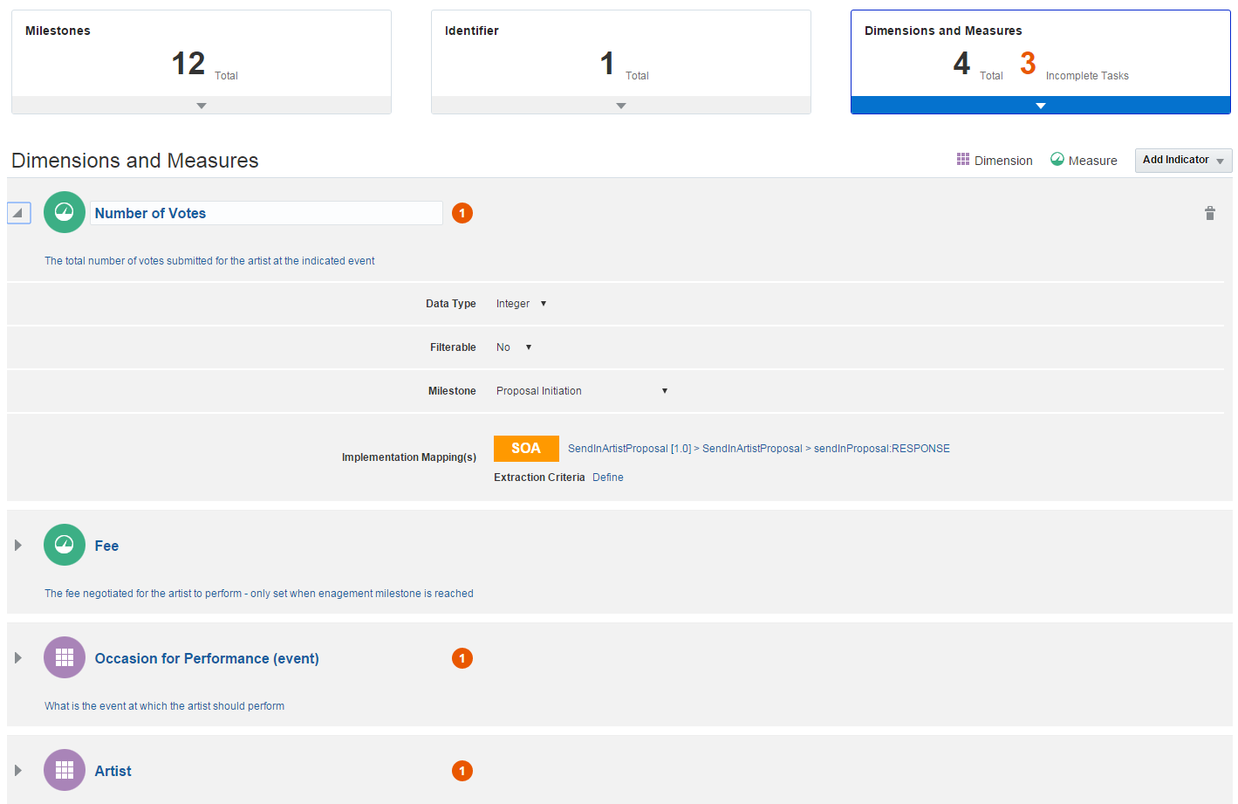
Defining Business Indicators

Slide 24
Defining Business Indicators

Slide 25
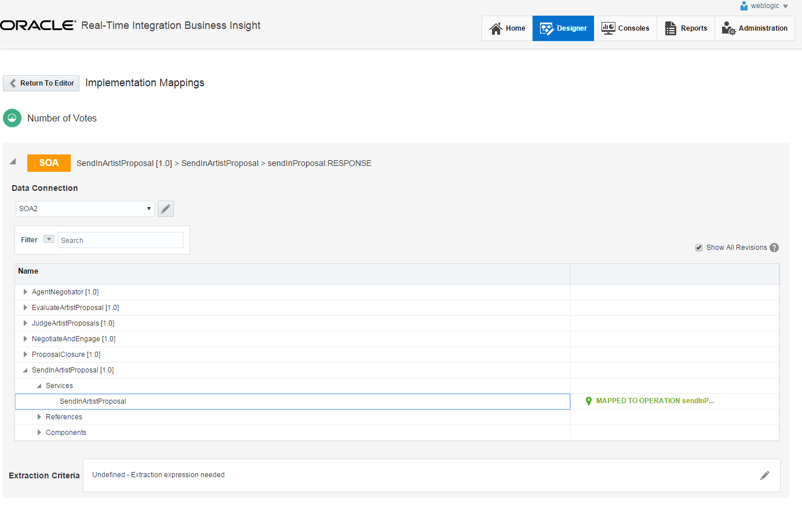
Defining Business Indicators

Slide 26
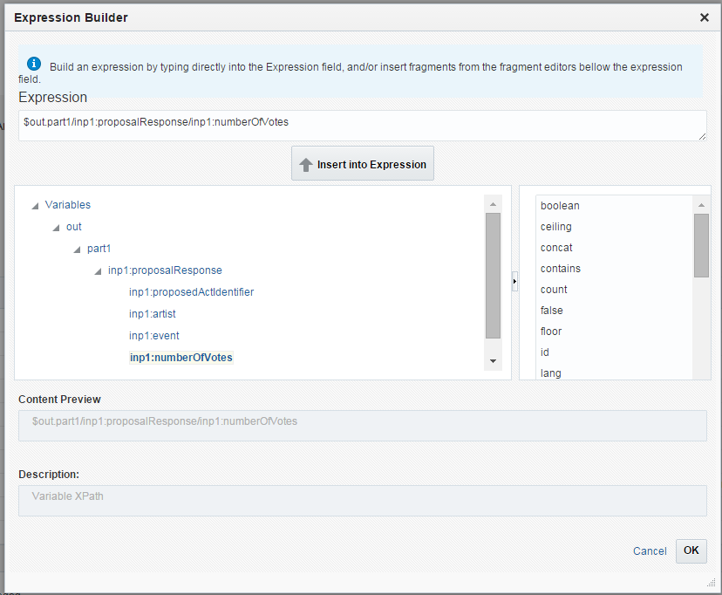
Defining Business Indicators

Slide 27
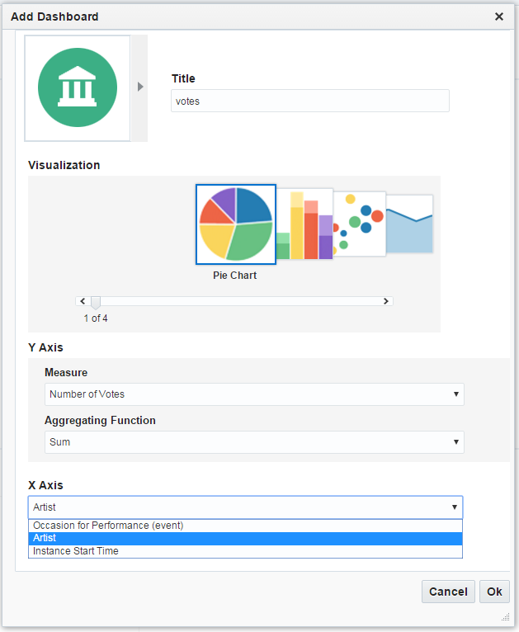
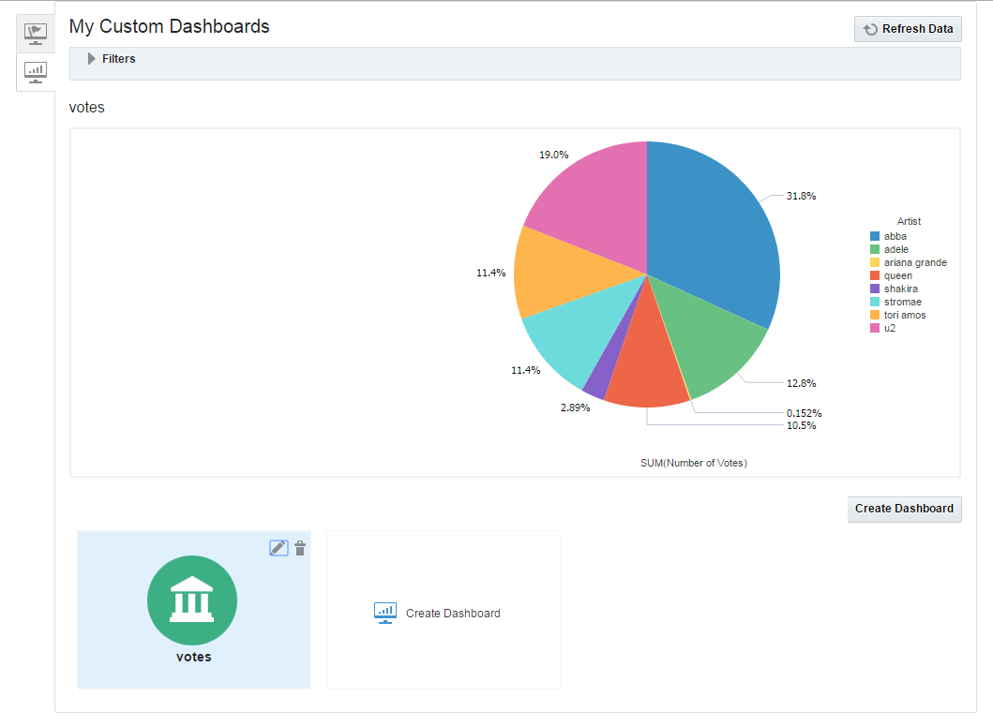
Creating Custom Dashboards
Set title
Select Type of Visualization
Four chart types supported
Select Measure
To plot
To aggregate and plot
Select aggregation function
Select dimension
To plot against (X-axis)
To aggregate by
Define grouping
For stacked bar chart or bubble chart

Slide 28
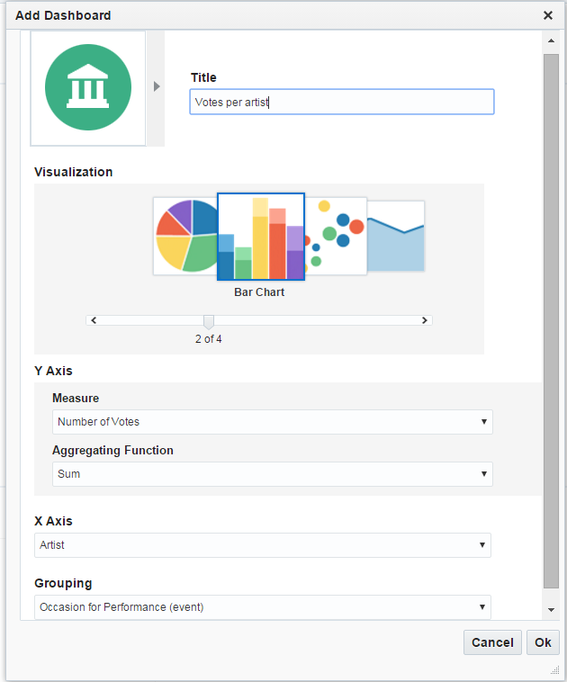
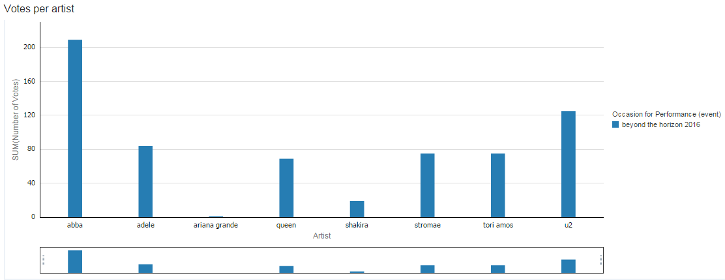
Comparing Number of Votes per Artist (grouped by event)

Slide 29
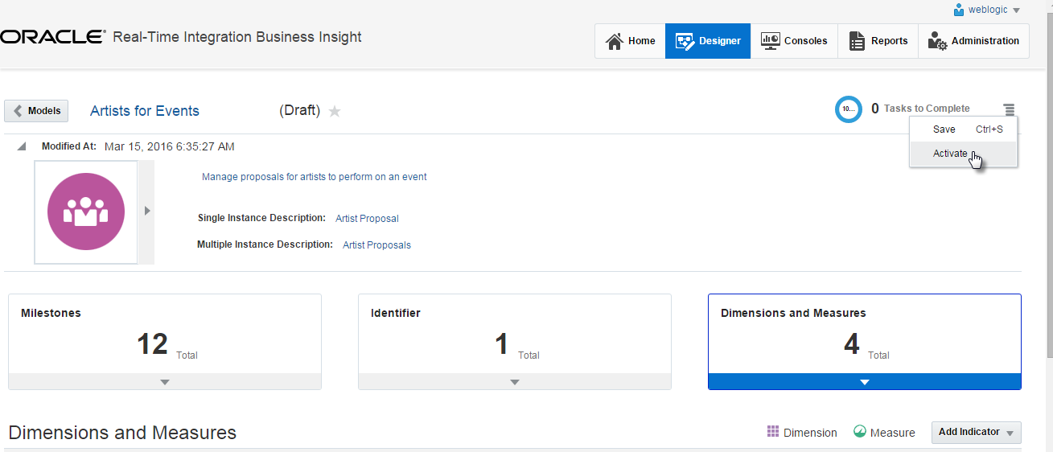
Activate Model
After defining the model – business definitions and implementation mapping – it needs to be activated

Slide 30
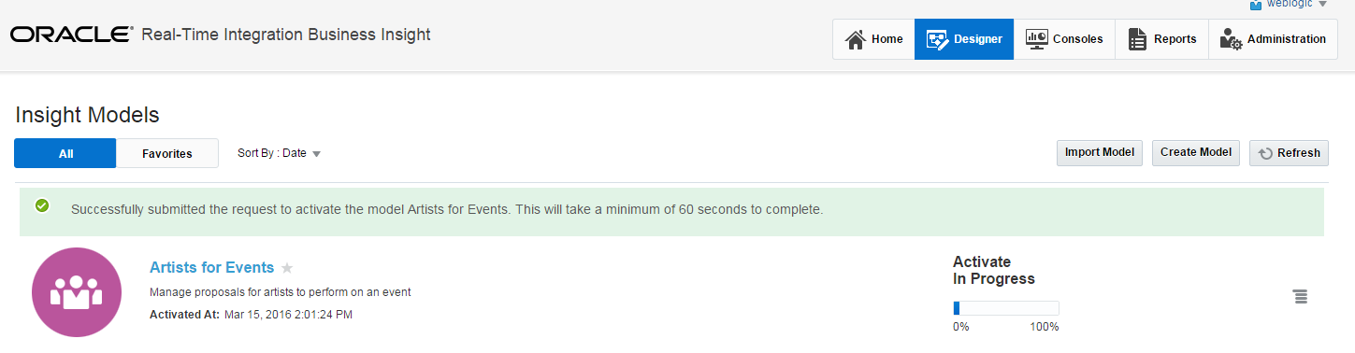
Activation taking place
During activation –BAM definitions and corresponding database views are created
After activation: collection of metrics is started
Note: models can be exported and imported
Import is the equivalent of deployment

Slide 31
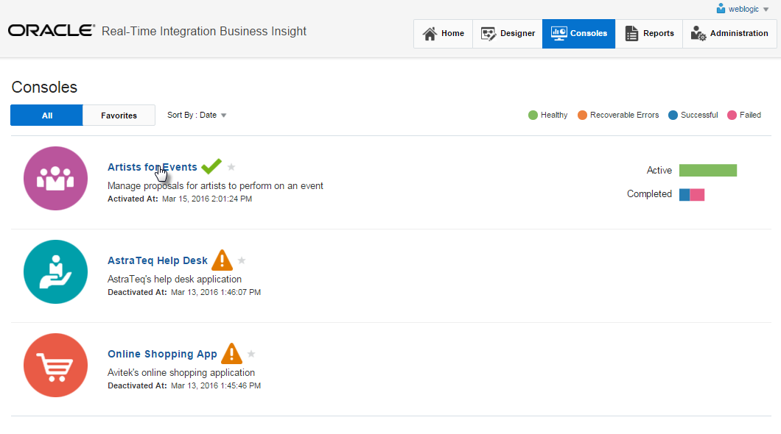
Insight Consoles

Slide 32
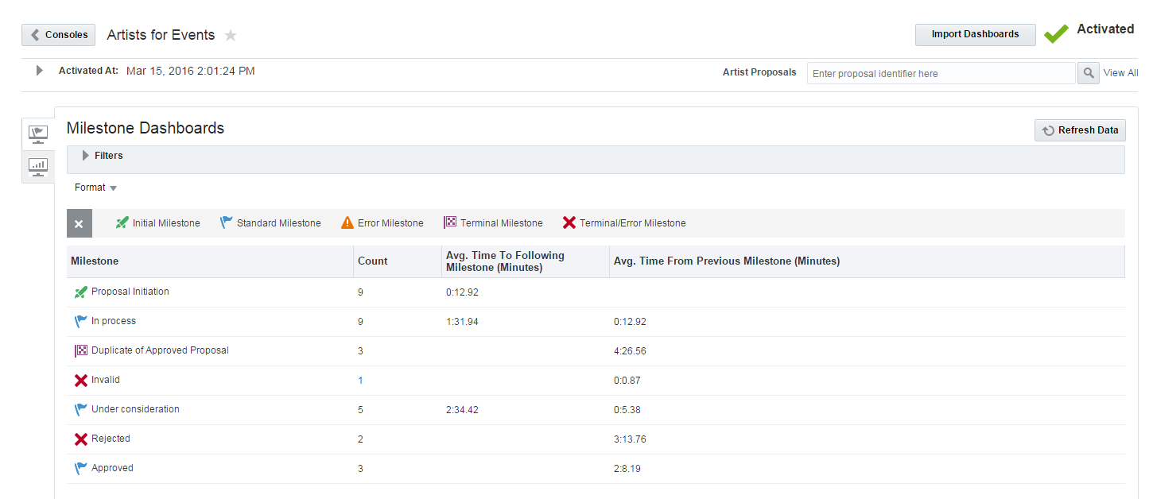
Tabular overview of milestones and #instances & average times
Main overview – Milestone Dashboard

Slide 33
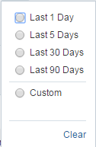
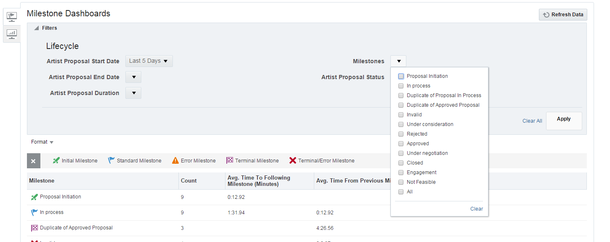
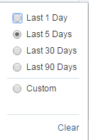
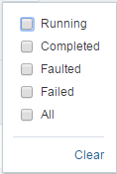
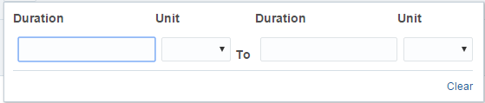
Dashboard Filters

Slide 34
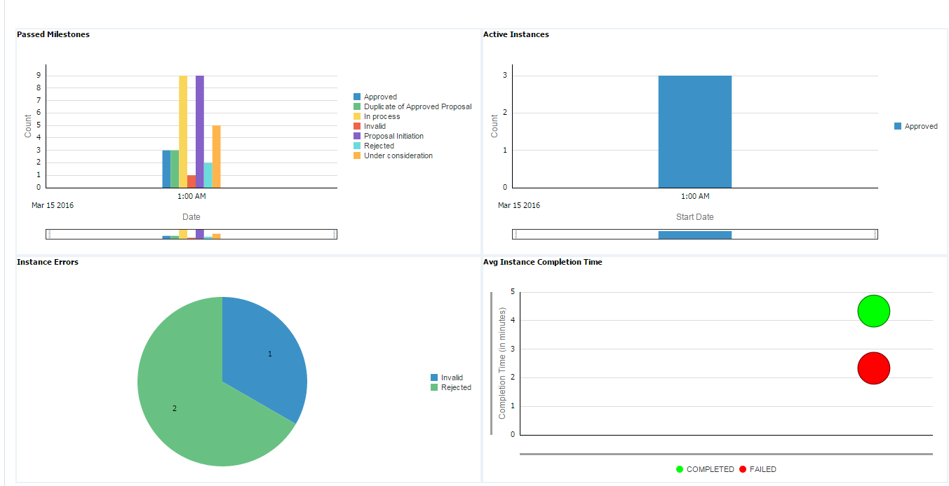
Out of the box charts

Slide 35
Custom Dashboard

Slide 36
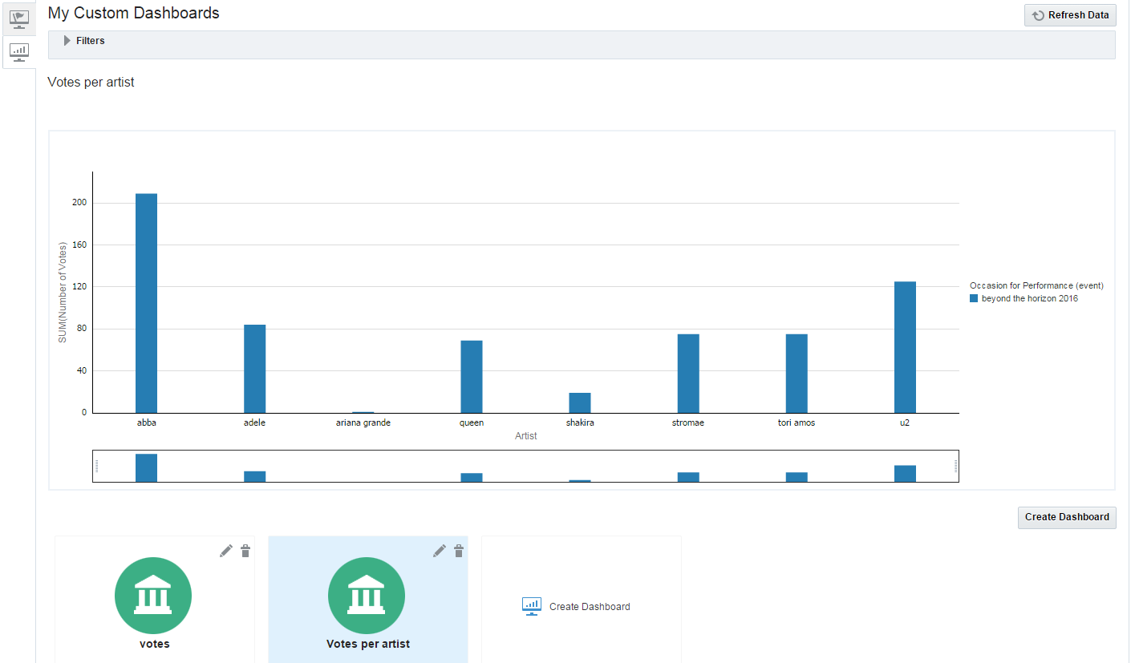
Votes per artist (per event)

Slide 37
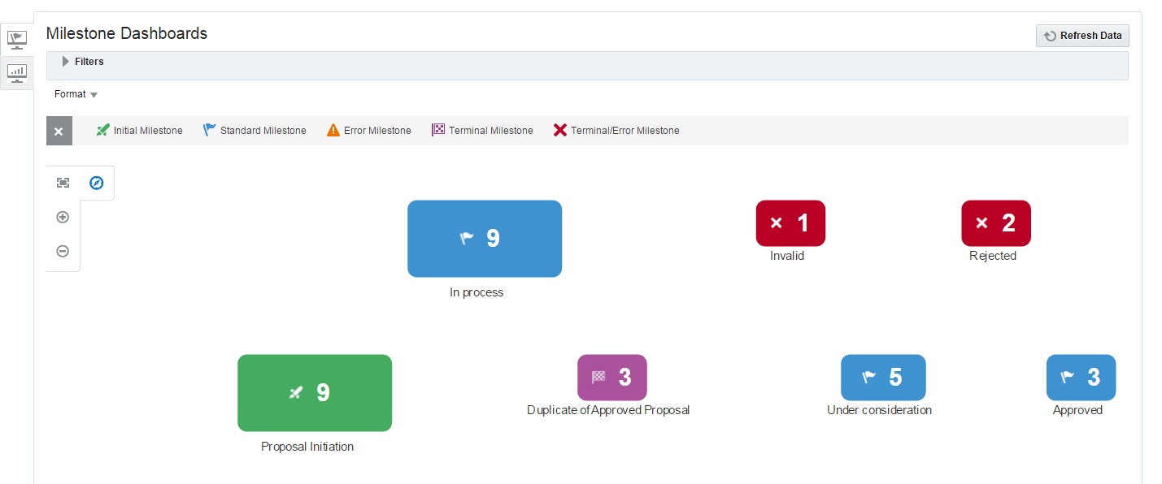
Graphical overview of number of instances per milestone

Slide 38
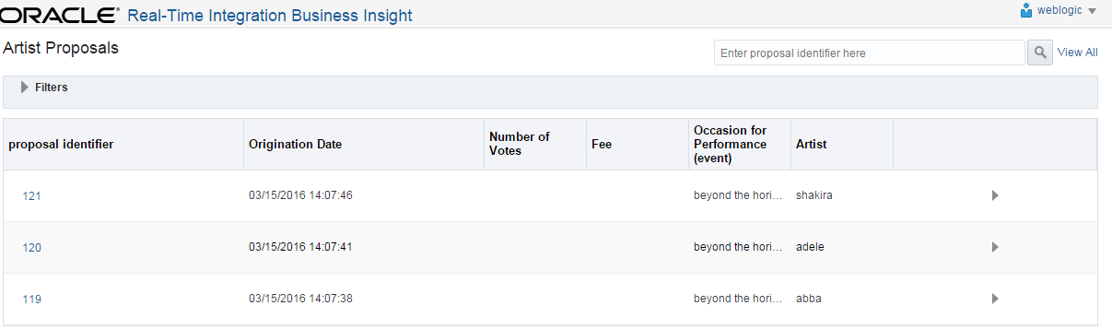
Drill down on instances

Slide 39
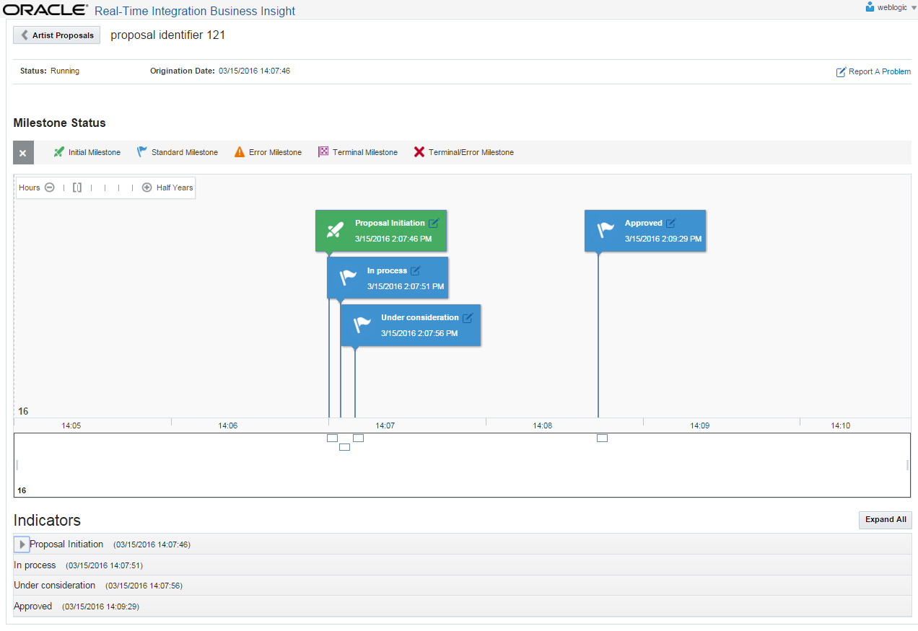
Timeline for a specific instance

Slide 40
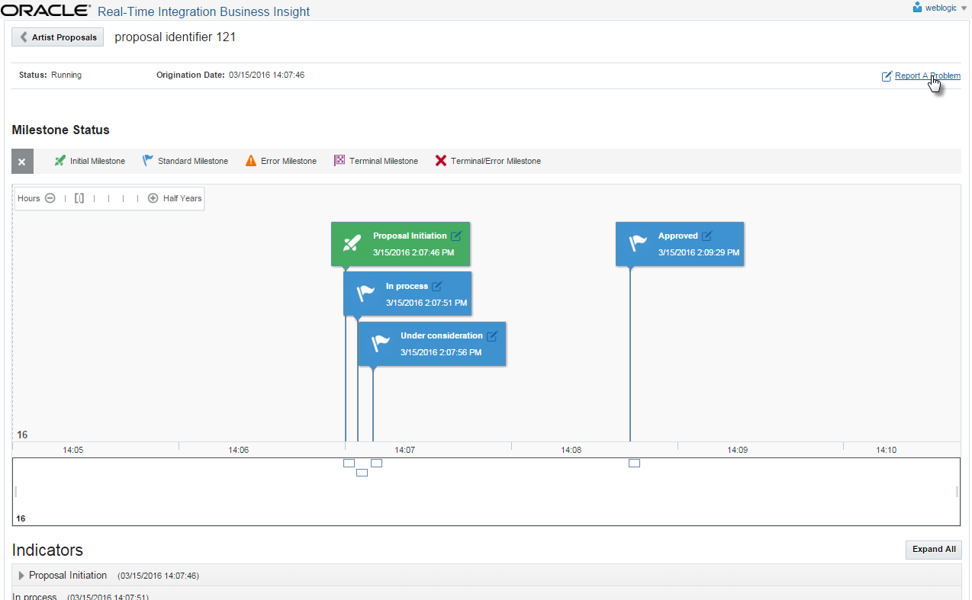
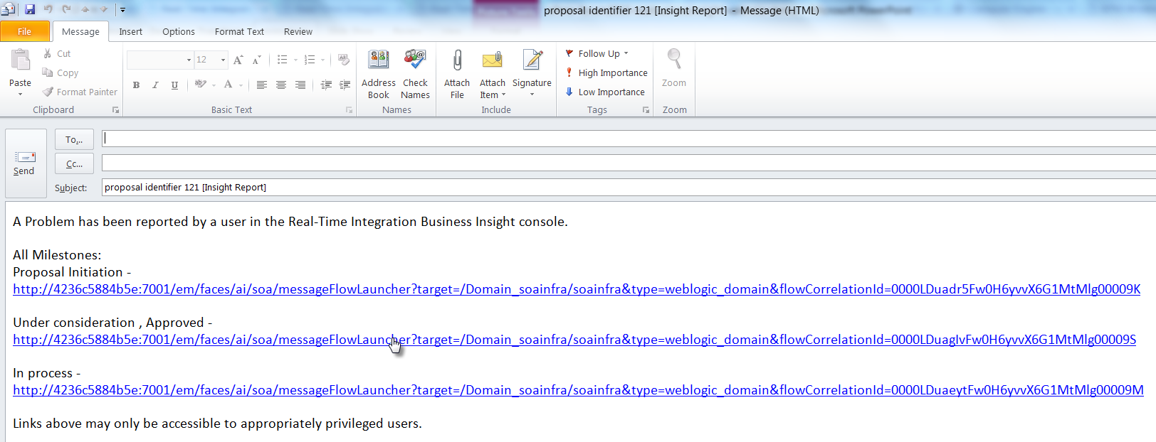
Report a problem – send email with deeplink

Slide 41
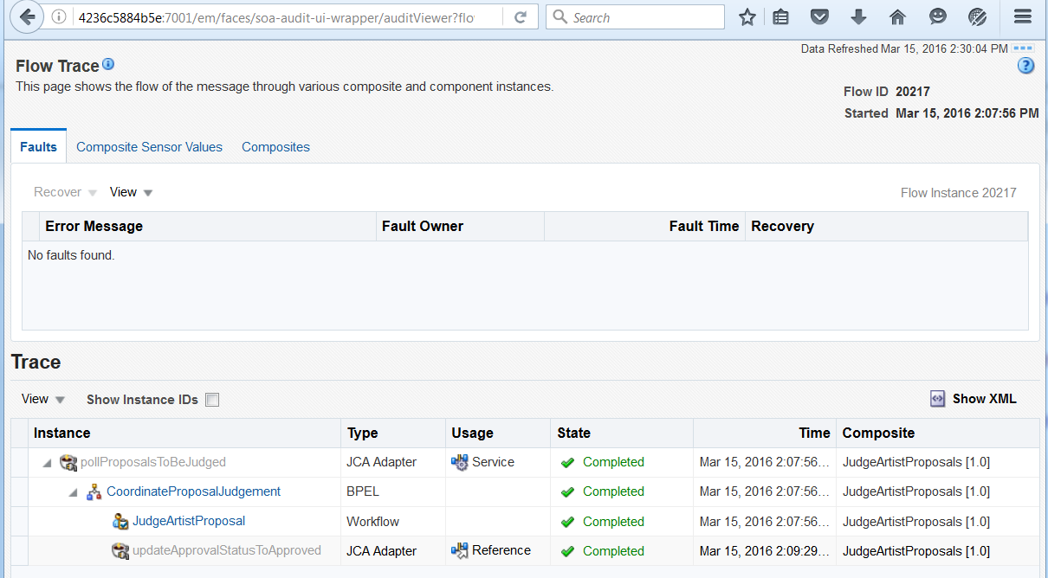
Deeplink leads to Flow trace associated with milestone

Slide 42
Send in new proposals
Create a series of new instances by sending in artist proposals
One invalid (too few votes)
One duplicate (for an existing, approved artist)
One duplicate for an artist currently being approved
Five regular ones
At least one based on an audience suggestion, with a large number of votes
Show in the flow layout
The new instances that have been added
Point out the duplicate and invalid ones – drill down to instance, show business indicator values
Show timeline for a specific instance
Show Custom Charts
BPM Worklist - Show the instances to be approved
Approve some, reject some others
Show the Insight console and the results from Approve Reject

Slide 43
Recover instance
The instance in the error milestone “Duplicate of in process” can be revisited and recovered
When the first one is approved, the next one should be upgraded to ‘Duplicate of approved’ and be processed as such after recovery
Click on pencil icon
Mail client opens with deeplink URL
Use URL in email to bring up the instance in the EM Flow Trace
Recover the instance from there

Slide 44
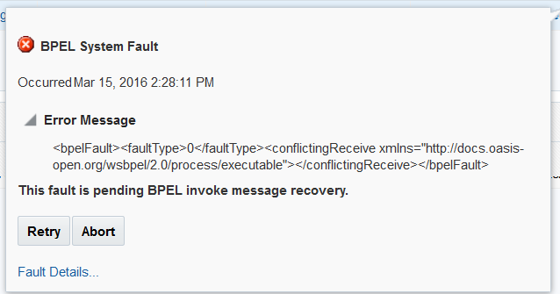
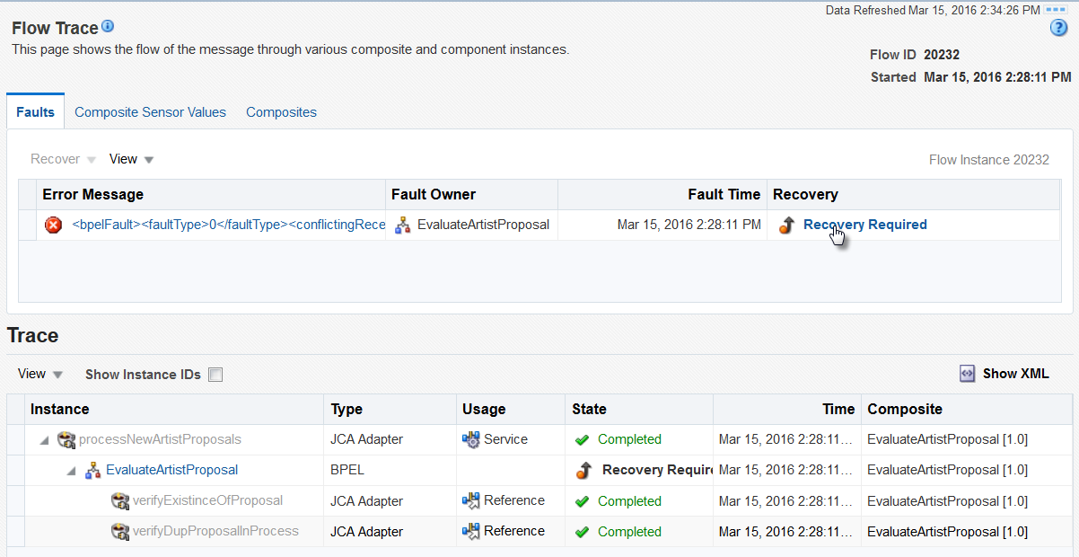
From actionable email, navigate deeply into EM

Slide 45
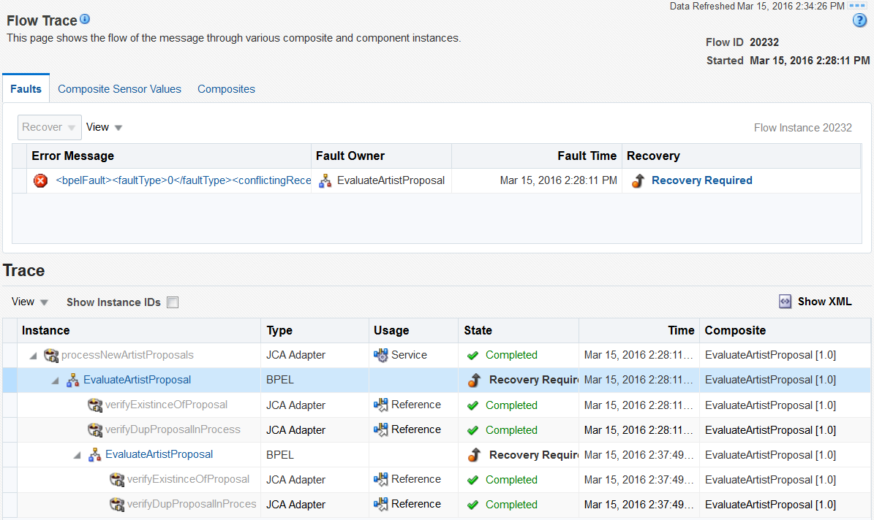
Recover the failed instance in milestone Duplicate of in process

Slide 46
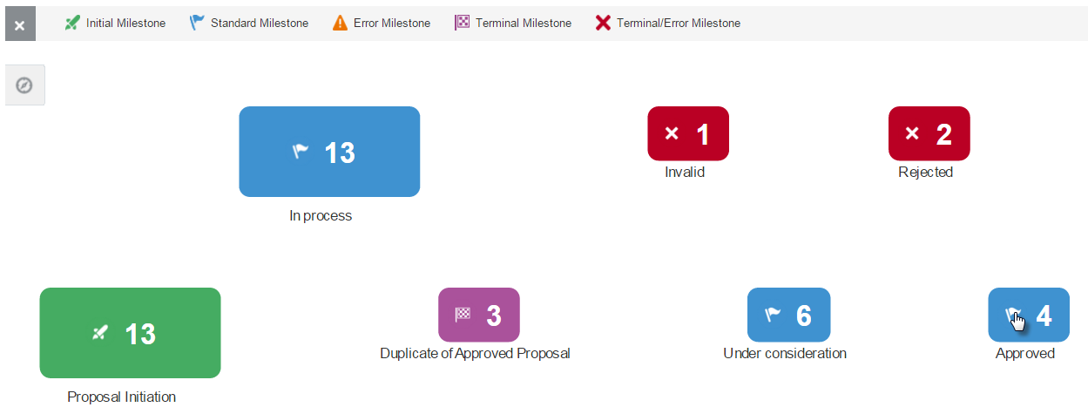
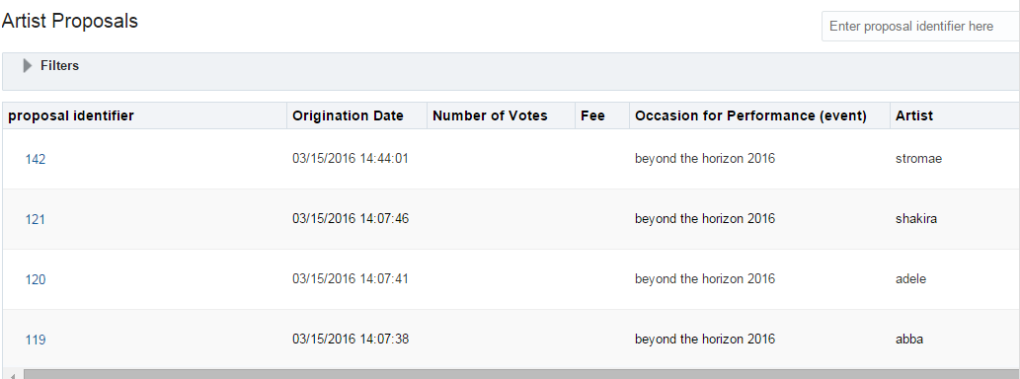
Negotation Stage

Slide 47
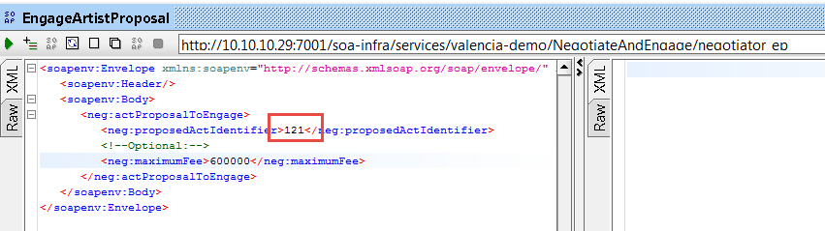
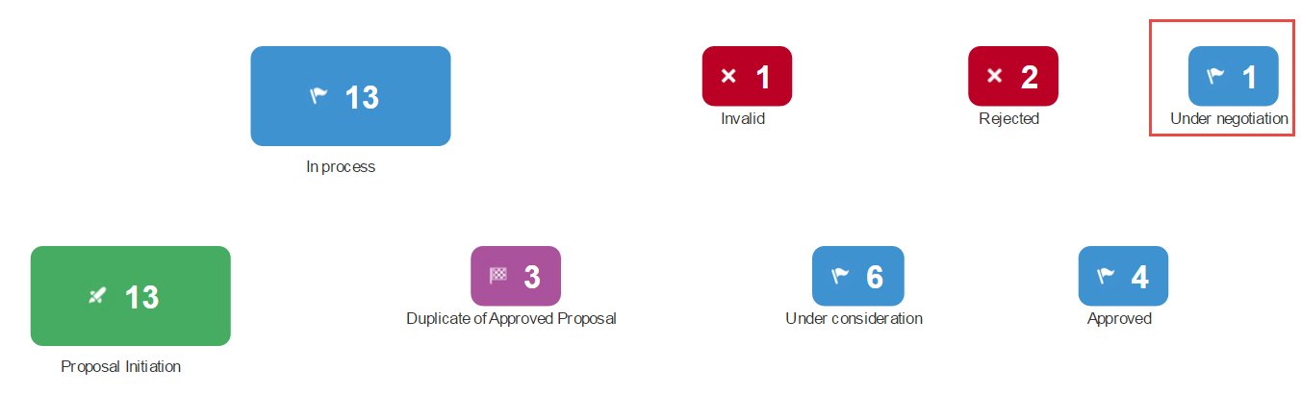
Start negotiation for proposal

Slide 48
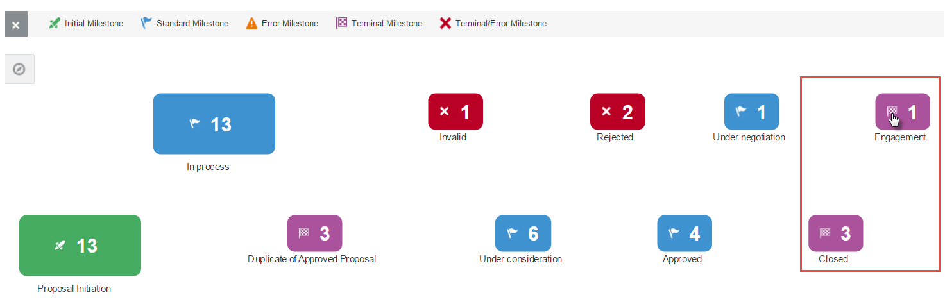
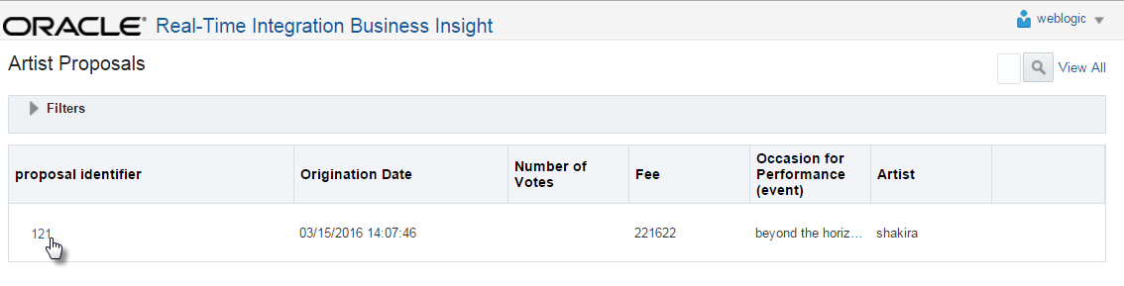
After some time – the negotiation succeeds or fails

Slide 49
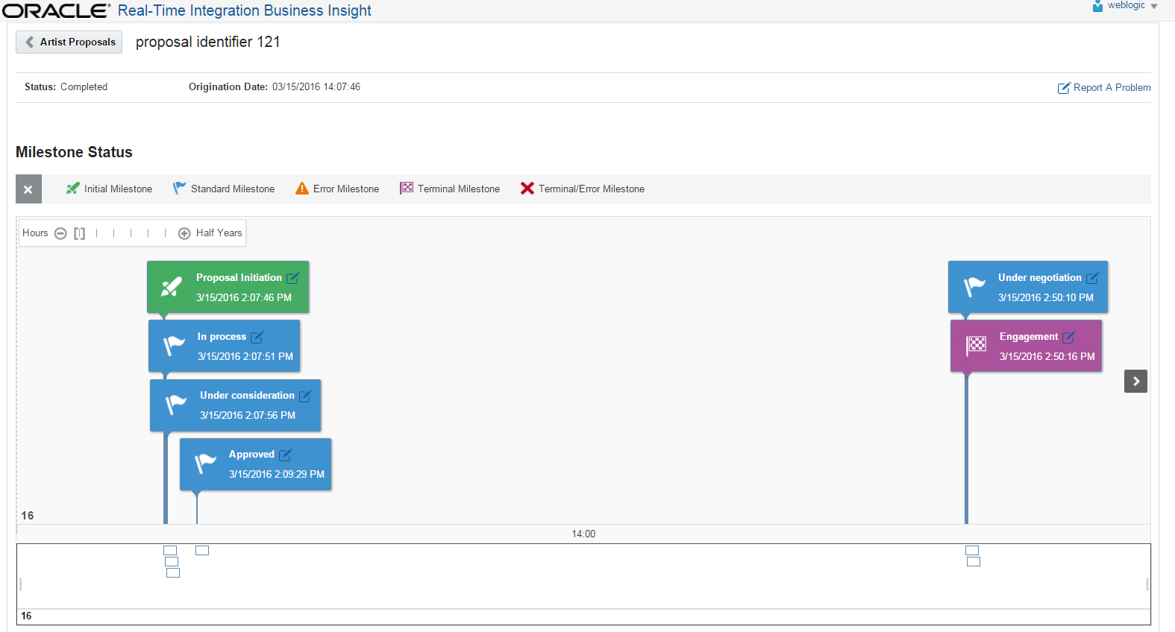
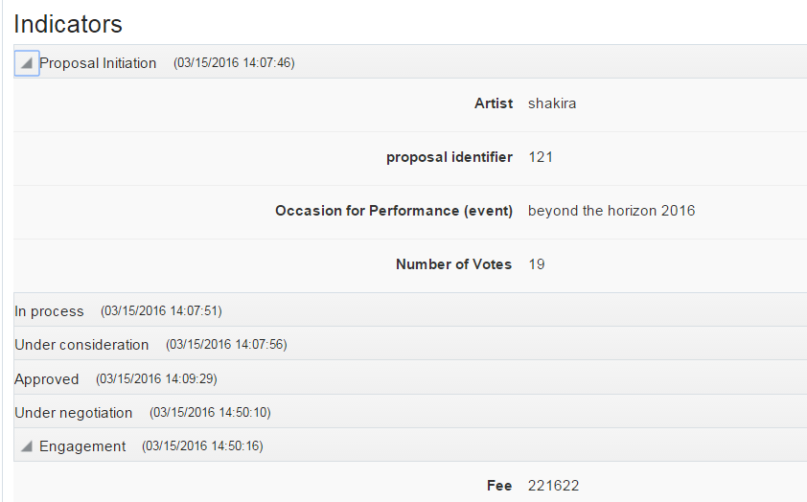
Lifecycle of Instance 121 – succesfully engaged

Slide 50
Lifecycle of Instance 121 – succesfully engaged

Slide 51
Next Steps
Iteratively refine the model
Create a draft, modify configuration, activate refined model
Redeploy SB and SOA applications
Model stays valid if all mappings are still valid
Create additional models
Even on top of the same underlying Service Bus and SOA components
Exploit collected data in OBI EE
Out of the box reports
Leverage BAM
All Insight metrics are exposed through BAM Data Objects and can be utilized in your own custom Business Views and Dashboards
Do anything you like through SQL
Underlying Insight & BAM are database views and tables

Slide 52

When? Conditions? Where?

Slide 53

Wednesday – all-day workshops, welcome reception
Thursday – breakfast, 8 rooms, 50+ sessions, UX experience, dinner & party
Friday – breakfast, early birds sessions, 8 rooms, 50+ sessions
Weekend – to the beach | to Amsterdam | to the tourist attractions of Holland

